Slide 1
Welcome to FeCRA’s 2022 event Cambridge for Sale - Who’s Buying
FeCRA Officers
Wendy Blythe
Jean Glasberg
John Latham

Slide 2
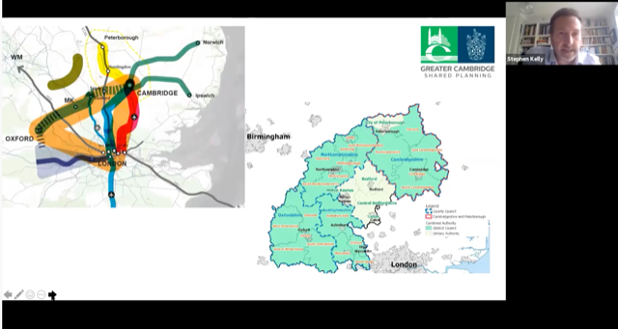
Stephen Kelly , ‘This is not the only Arc we face - there is one going to London - one going to Norwich and one up to Peterborough and beyond'
The Director for Economic Growth and Planning at the Greater Cambs Shared Planning Service was referring to the OxCam Arc. The planning service he directs is funded by Cambridge University.

Slide 3
Warm Welcome from Cambridge RA’s to Ukrainian refugees
Mums4Ukraine is a small charity started by RA members
practical support for women and Mums coming to Cambridge as refugees
People who could consider hosting are urgently needed
Children and mums in need of reassurance and security after worlds have been turned up-side down
19 Nov Pop into St John’s Church, Hills Rd & enjoy delicious Ukrainian cooking

Slide 4
Vigorous community responses achieved a favourable outcome
raised the profile of the very limited tree coverage of North Petersfield,
underscored the importance of protecting all of these existing trees; and
enhanced communication between residents, ward councillors and tree officers

Slide 5
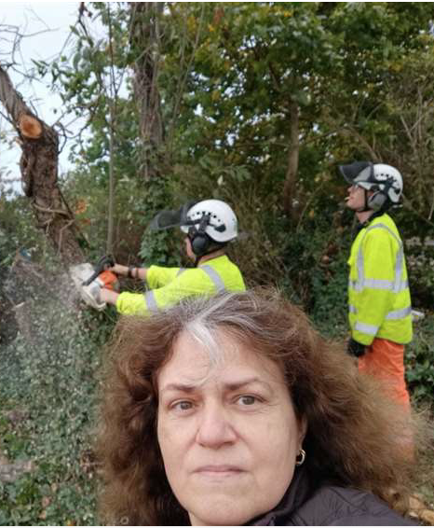
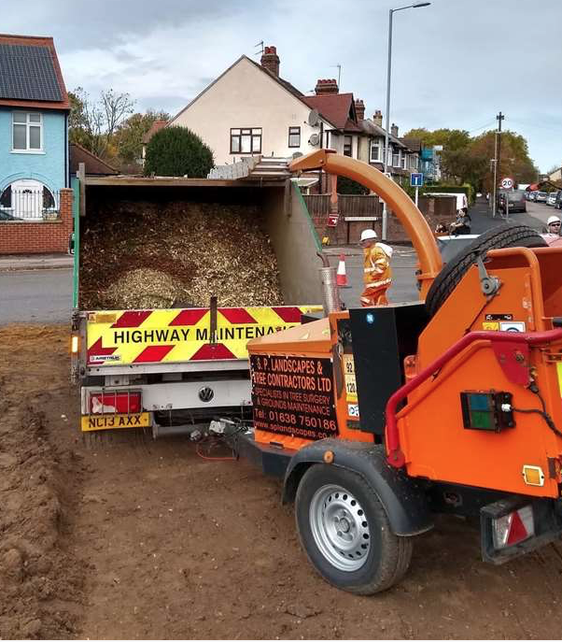
Sadly, West Chesterton residents were not able to save the trees and wildlife site on the Milton Road Highworth Avenue Roundabout despite a long, eight day vigil.

Slide 6
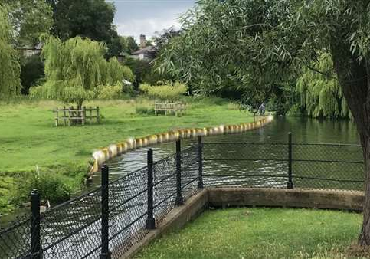
‘The River speaks for itself – it doesn’t need any gold decoration’
Residents were very glad that the Council listened to their views and decided to cancel the project , with the money remaining allocated to other S106 projects.

Slide 7
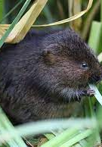
A genuine regeneration opportunity
Residents say Cherry Hinton Brook and the Lakes that are adjacent to it could be an important wildlife corridor and city nature reserve .

Slide 8
www.fecra.org.uk View filmed meetings on the FeCRA YouTube channel Sign up as an individual to the FeCRA Mailing List Join your Residents’ Association With FeCRA support, consider starting an RA Support filming and meetings by donating generously THANK YOU! wendy.blythe.fecra@gmail.com

